Slide 1

The chain of Andrej Markov and its applications
NETWORKS goes to school - April 23, 2018
Jan-Pieter Dorsman

Slide 2
Some history…
Andrej Andrejevitz Markov sr. (1856-1922)
Markov’s inequality
Markov numbers
Markov networks
Markov processes
Markov chains
Andrej Andrejevitz Markov jr. (1903-1979)
    Markov’s principle
    Markov algoritm
    Markov’s rule

Slide 3
Some history…
Andrej Andrejevitz Markov sr. (1856-1922)
Markov’s inequality
Markov numbers
Markov networks
Markov processes
Markov chains
Andrej Andrejevitz Markov jr. (1903-1979)
    Markov’s principle
    Markov algoritm
    Markov’s rule

Slide 4
Markov chain
A Markov chain describes something that moves step-by-step through a number of states and exhibits transitions from one state to another (or the same) state.
In particular, the so-called Markov property holds:
“The future, given the present, does not depend on the past.”

Slide 5
The weather as Markov chain
The situation:
If it is sunny today, it will also be sunny tomorrow with probability 90%, but rainy with 10% probability.
If it is rainy today, it will be sunny tomorrow with 40% probability, but it will remain rainy with 60% probability.
This is a Markov chain with two possible states: sunny and rainy. We can summarise this situation in a graph:
10%
90%
Sunny
Rainy
60%
40%

Slide 6

10%
90%
Sunny
Rainy
60%
40%
We can also summarise this in a matrix, which we call P. P is then called the one-step transition matrix.
State space: {Sunny, Rainy}
To
Sunny Rainy
From Sunny
Rainy
Possible questions we could ask:
What is the probability, if it is rainy today, that it will be sunny the day after tomorrow?
If it is sunny on Monday, how many sunny days will we have on average from Monday until (and including) Thursday?
What percentage of time will it be sunny in the long run?
$$P=\left[\begin{matrix}0.9 & 0.1 \\ 0.4 & 0.6\end{matrix}\right]$$

Slide 7



10%
90%
Sunny
Rainy
60%
40%
Q: Wat is the probability, if it is rainy today, that it will be sunny the day after tomorrow?
A: If sunny tomorrow (prob. 0.4), then day after tomorrow sunny with prob. 0.9. 0.4x0.9 = 0.36
If rainy tomorrow (prob 0.6), then day after tomorrow sunny with prob. 0.4. 0.6x0.4 = 0.24 +
In total: 0.60
Q: But what if it didn’t say ‘day after tomorrow’, but ‘in eight days from now’?
A: To this end, we use so-called matrix-multiplication:
From
Sunny Rainy
From Sunny
Rainy
This is the two-step transition matrix!
$$P^{2}=P×P=\left[\begin{matrix}0.9 & 0.1 \\ 0.4 & 0.6\end{matrix}\right]×\left[\begin{matrix}0.9 & 0.1 \\ 0.4 & 0.6\end{matrix}\right]$$
$=\left[\begin{matrix}0.9×0.9+0.1×0.4 & 0.9×0.1+0.1×0.6 \\ 0.4×0.9+0.6×0.4 & 0.4×0.1+0.6×0.6\end{matrix}\right]$
$=\left[\begin{matrix}0.85 & 0.15 \\ 0.6 & 0.4\end{matrix}\right]$

Slide 8
10%
90%
Sunny
Rainy
60%
40%
Q: Wat is the probability, if it is rainy today, that it will be sunny in eight days from now?
A: To this end, we use so-called matrix-multiplication:
So the probability is 0.797. Hard to compute this by mental calculation!
$$P^{4}=P×P×P×P=P^{2}×P^{2}$$
$$=\left[\begin{matrix}0.85 & 0.15 \\ 0.6 & 0.4\end{matrix}\right]×\left[\begin{matrix}0.85 & 0.15 \\ 0.6 & 0.4\end{matrix}\right]=\left[\begin{matrix}0.8125 & 0.1875 \\ 0.75 & 0.25\end{matrix}\right]$$
$$P^{8}=P^{4}×P^{4}$$
$$=\left[\begin{matrix}0.8125 & 0.1875 \\ 0.75 & 0.25\end{matrix}\right]×\left[\begin{matrix}0.8125 & 0.1875 \\ 0.75 & 0.25\end{matrix}\right]=\left[\begin{matrix}0.801 & 0.199 \\ 0.797 & 0.203\end{matrix}\right]$$

Slide 9
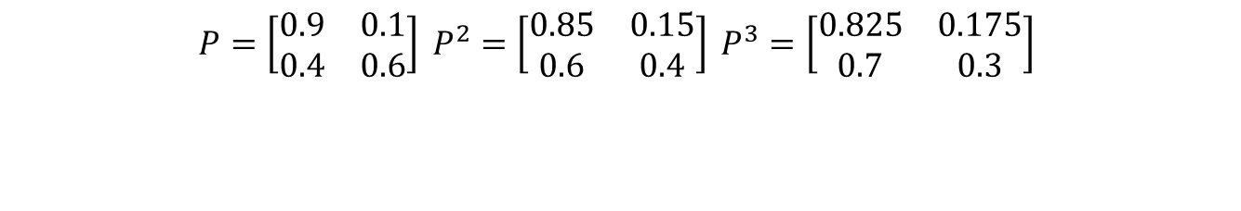
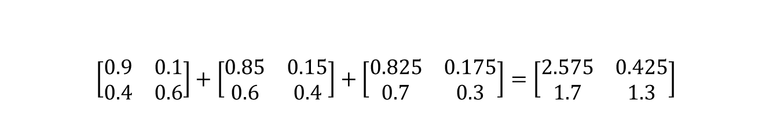
10%
90%
Sunny
Rainy
60%
40%
Q: If it is sunny on Monday, how many sunny days will we have on average between Monday until (and including) Thursday?
A: Again, we check our matrices:
Tuesday Wednesday Thursday
If it sunny on Monday, then we will have on average 2.575 sunny days between Tuesday until (and including) Thursday.
So the answer is 3.575!
$$P=\left[\begin{matrix}0.9 & 0.1 \\ 0.4 & 0.6\end{matrix}\right] P^{2}=\left[\begin{matrix}0.85 & 0.15 \\ 0.6 & 0.4\end{matrix}\right] P^{3}=\left[\begin{matrix}0.825 & 0.175 \\ 0.7 & 0.3\end{matrix}\right]$$
$\left[\begin{matrix}0.9 & 0.1 \\ 0.4 & 0.6\end{matrix}\right]+\left[\begin{matrix}0.85 & 0.15 \\ 0.6 & 0.4\end{matrix}\right]+\left[\begin{matrix}0.825 & 0.175 \\ 0.7 & 0.3\end{matrix}\right]=\left[\begin{matrix}2.575 & 0.425 \\ 1.7 & 1.3\end{matrix}\right]$

Slide 10

10%
90%
Sunny
Rainy
60%
40%
Q: What percentage of time will it be sunny in the long run?
A: Let’s have another look at the matrices…
Wait a minute… what if we continue like this?
If we would continue, we would obtain
So the answer is 80%.
The fine print: 0.8 and 0.2 together form the normalised left eigenvector of P corresponding to eigenvalue 1.
$$P=\left[\begin{matrix}0.9 & 0.1 \\ 0.4 & 0.6\end{matrix}\right] P^{2}=\left[\begin{matrix}0.85 & 0.15 \\ 0.6 & 0.4\end{matrix}\right] P^{3}=\left[\begin{matrix}0.825 & 0.175 \\ 0.7 & 0.3\end{matrix}\right]$$
$$P^{4}= \left[\begin{matrix}0.8125 & 0.1875 \\ 0.75 & 0.25\end{matrix}\right] P^{8}=\left[\begin{matrix}0.801 & 0.199 \\ 0.797 & 0.203\end{matrix}\right]$$
$$P^{10}=\left[\begin{matrix}0.800195 & 0.199805 \\ 0.799219 & 0.200781\end{matrix}\right] P^{12}= \left[\begin{matrix}0.800049 & 0.199951 \\ 0.799805 & 0.2000195\end{matrix}\right]$$
$$P^{∞}= \left[\begin{matrix}0.8 & 0.2 \\ 0.8 & 0.2\end{matrix}\right].$$

Slide 11
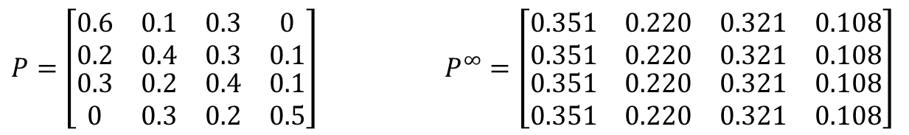
The weather as Markov chain
10%
60%
Sunny
Rainy
40%
20%
30%
30%
30%
20%
30%
10%
40%
Cloudy
10%
Stormy
50%
20%
$P=\left[\begin{matrix}\begin{matrix}0.6 & 0.1 \\ 0.2 & 0.4\end{matrix} & \begin{matrix}0.3 & 0 \\ 0.3 & 0.1\end{matrix} \\ \begin{matrix}0.3 & 0.2 \\ 0 & 0.3\end{matrix} & \begin{matrix}0.4 & 0.1 \\ 0.2 & 0.5\end{matrix}\end{matrix}\right] P^{∞}=\left[\begin{matrix}\begin{matrix}0.351 & 0.220 \\ 0.351 & 0.220\end{matrix} & \begin{matrix}0.321 & 0.108 \\ 0.321 & 0.108\end{matrix} \\ \begin{matrix}0.351 & 0.220 \\ 0.351 & 0.220\end{matrix} & \begin{matrix}0.321 & 0.108 \\ 0.321 & 0.108\end{matrix}\end{matrix}\right]$
If it is cloudy today, an arbitrary day in the distant future will be cloudy with probability 32.1%. But, it doesn’t matter what the state today is.
If it is cloudy today, in the long run 32.1% of all days will be cloudy. But again, the state of today does not matter.

Slide 12
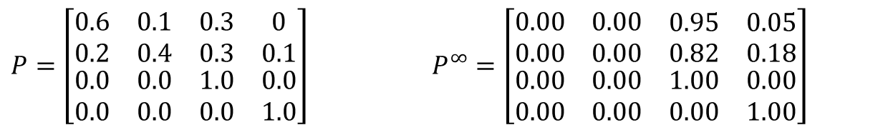
The weather as Markov chain
10%
60%
Sunny
Rainy
40%
20%
30%
30%
10%
100%
Cloudy
Stormy
100%
$P=\left[\begin{matrix}\begin{matrix}0.6 & 0.1 \\ 0.2 & 0.4\end{matrix} & \begin{matrix}0.3 & 0 \\ 0.3 & 0.1\end{matrix} \\ \begin{matrix}0.0 & 0.0 \\ 0.0 & 0.0\end{matrix} & \begin{matrix}1.0 & 0.0 \\ 0.0 & 1.0\end{matrix}\end{matrix}\right] P^{∞}=\left[\begin{matrix}\begin{matrix}0.00 & 0.00 \\ 0.00 & 0.00\end{matrix} & \begin{matrix}0.95 & 0.05 \\ 0.82 & 0.18\end{matrix} \\ \begin{matrix}0.00 & 0.00 \\ 0.00 & 0.00\end{matrix} & \begin{matrix}1.00 & 0.00 \\ 0.00 & 1.00\end{matrix}\end{matrix}\right]$
If it is cloudy today, an arbitrary day in the distant future will be cloudy with probability 100%. But, it really depends on today’s state of weather.
We just do not know what percentage of time it will be cloudy in the future. It depends on the state of weather today.

Slide 13
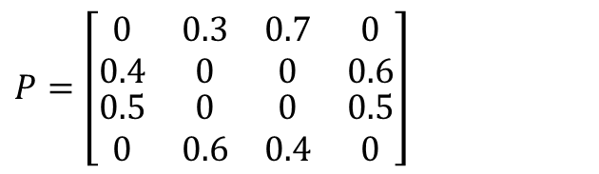
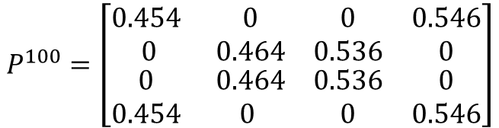
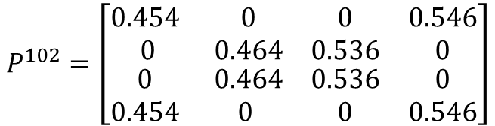
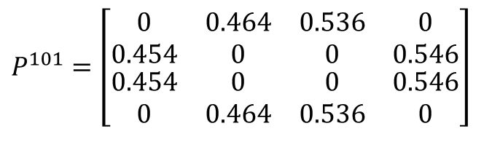
The weather as Markov chain
30%
Sunny
Rainy
40%
70%
50%
60%
60%
Cloudy
50%
Stormy
40%
$P=\left[\begin{matrix}\begin{matrix}0 & 0.3 \\ 0.4 & 0\end{matrix} & \begin{matrix}0.7 & 0 \\ 0 & 0.6\end{matrix} \\ \begin{matrix}0.5 & 0 \\ 0 & 0.6\end{matrix} & \begin{matrix} 0 & 0.5 \\ 0.4 & 0\end{matrix}\end{matrix}\right]$
If it is cloudy today, an arbitrary day in the distant future will be cloudy with probability 26.8%. It does not really depend on today’s weather.
If it is sunny today, it will be cloudy 26.8% of the time in the long run. Also here, today’s weather does not really matter.
$$P^{100}=\left[\begin{matrix}\begin{matrix}0.454 & 0 \\ 0 & 0.464\end{matrix} & \begin{matrix}0 & 0.546 \\ 0.536 & 0\end{matrix} \\ \begin{matrix}0 & 0.464 \\ 0.454 & 0\end{matrix} & \begin{matrix}0.536 & 0 \\ 0 & 0.546\end{matrix}\end{matrix}\right]$$
$P^{101}=\left[\begin{matrix}\begin{matrix}0 & 0.464 \\ 0.454 & 0\end{matrix} & \begin{matrix}0.536 & 0 \\ 0 & 0.546\end{matrix} \\ \begin{matrix}0.454 & 0 \\ 0 & 0.464\end{matrix} & \begin{matrix} 0 & 0.546 \\ 0.536 & 0\end{matrix}\end{matrix}\right]$
$$P^{102}=\left[\begin{matrix}\begin{matrix}0.454 & 0 \\ 0 & 0.464\end{matrix} & \begin{matrix}0 & 0.546 \\ 0.536 & 0\end{matrix} \\ \begin{matrix}0 & 0.464 \\ 0.454 & 0\end{matrix} & \begin{matrix}0.536 & 0 \\ 0 & 0.546\end{matrix}\end{matrix}\right]$$

Slide 14
Google’s search engine
In a way, Google’s search engine is a mathematical function: f(x) = y.
  x is the search query
  y contains all websites where ‘x’ appears, presented in a certain sequence
This function is determined by Google’s PageRank algorithm.
This algorithm searches through a huge network!

Slide 15
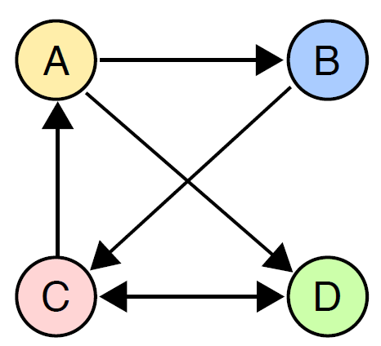
Internet: PageRank algorithm
Idea 1: each incoming hyperlink is a ‘vote’ for a website.
Websites A and B each get 1 votes.
Websites C and D both get 2 votes.
In shares: (0.167, 0.167, 0.33, 0.33)
C & D are on top, A & B are on the bottom.
Idea 2: a vote of an important website is worth more than a vote of a not so important website.

Slide 16
Internet: PageRank algorithm
Start with an arbitrary distribution of votes:
(0.25, 0.25, 0.25, 0.25)
Divide the votes of each website equally
  over the websites where the website
  links to.
Repeat step 2 until the distribution of
votes does not change anymore.

Slide 17
Internet: PageRank algorithm
(0.25, 0.25, 0.25, 0.25)
A receives 0.125 votes from C
B receives 0.125 votes from A
C receives 0.25 votes from B and
  0.25 votes from D
D receives 0.125 votes from A and
  0.125 votes from C
  (0.125, 0.125, 0.5, 0.25)

Slide 18
Internet: PageRank algorithm
(0.125, 0.125, 0.5, 0.25)
A receives 0.25 votes from C
B receives 0.0625 votes from A
C receives 0.125 votes from B and
  0.25 votes from D
D receives 0.0625 votes from A and
  0.25 votes from C
  (0.25, 0.0625, 0.375, 0.3125)

Slide 19
Internet: PageRank algorithm
( 43 iterations down the road…)

Slide 20

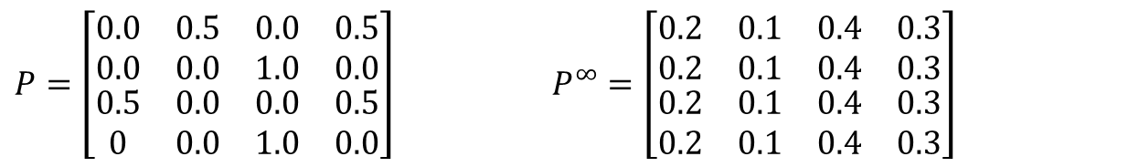
Internet: PageRank algorithm
The final distribution is:
(0.2, 0.1, 0.4, 0.3)
Google orders the websites in the
sequence C, D, A, B
In fact, this is a hidden Markov chain with
The PageRank algorithm is looking for the rows of $P^{∞}$ .
$P=\left[\begin{matrix}\begin{matrix}0.0 & 0.5 \\ 0.0 & 0.0\end{matrix} & \begin{matrix}0.0 & 0.5 \\ 1.0 & 0.0\end{matrix} \\ \begin{matrix}0.5 & 0.0 \\ 0 & 0.0\end{matrix} & \begin{matrix}0.0 & 0.5 \\ 1.0 & 0.0\end{matrix}\end{matrix}\right] P^{∞}=\left[\begin{matrix}\begin{matrix}0.2 & 0.1 \\ 0.2 & 0.1\end{matrix} & \begin{matrix}0.4 & 0.3 \\ 0.4 & 0.3\end{matrix} \\ \begin{matrix}0.2 & 0.1 \\ 0.2 & 0.1\end{matrix} & \begin{matrix}0.4 & 0.3 \\ 0.4 & 0.3\end{matrix}\end{matrix}\right]$

Slide 21
Internet: PageRank algorithm
Google indexes not just 4 websites,
but about 50 billion of them.
Next to this, the internet-network
is constantly changing! Websites appear,
change and disappear.
All this is stochastics.
As users, we expect an answer
in just a few milliseconds, so we need a fast algorithm anyway!
All considerations for future research.

